Slide 1


AIFE Semester
Examination-2026
M SAMPRIYAN
CSIT A (R25EJ060)
School of CSE
Program / Department:
AI Foundation For Engineers
Computer Science & Information Technology
Faculty Mentor: Prof. Kasi Viswanath

Slide 2

Portfolio Strategy & Team Profile
TEAM NAME:
APEX GP
TEAM MEMBERS:
1.DILIP NAIDHRUVA
2.HARSHIL NAIR
3.KARTHIK MR
4.M SAMPRIYAN
Objective
Develop practical software solutions using modern engineering tools and deploy them online.
Tools & Technologies
Python · Git & GitHub · HTML5 · CSS3 · JavaScript · GitHub Pages · Hugging Face AI
Portfolio Scope
4 projects spanning Python programming, AI analysis, and full web development.

Slide 3
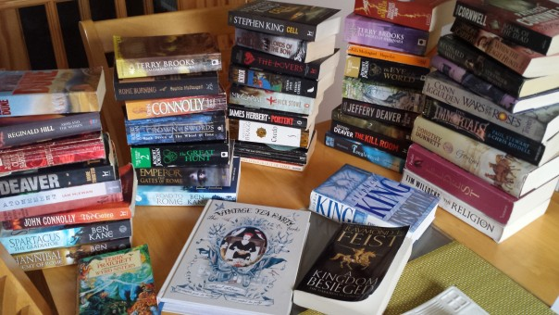
THE IMPORTANCE OF AI IN MODERN SOFTWARE ENGINEERING
Accelerated Coding Frameworks: Generative AI cuts down syntax debugging loops from hours to seconds, allowing engineers to focus on architectural system design.
Intelligent Refactoring: Machine learning assistants optimize computational code blocks for time and space complexity automatically.
Dynamic Data Simulation: AI enables immediate processing, classification, and validation of multi-variable metrics in live software models.
Production-Ready Quality Assurance: Automated test generation ensures high-reliability code bases before web deployment.

Slide 4
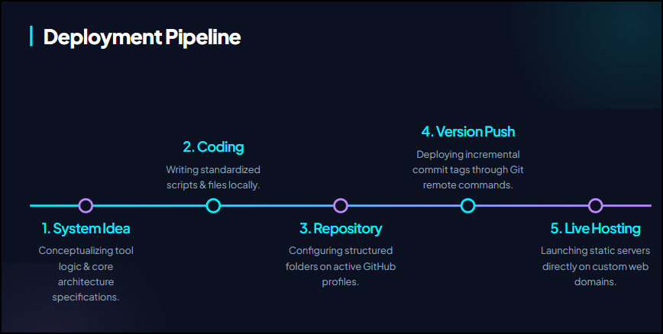
The Integrated Deployment Workflow
The AI Insertion Vector: Gemini is utilized at the transition from Idea to Development to instantly establish the technological boilerplate.
Version Control Foundations: Git branching strategies track granular codebase iterations, ensuring seamless deployment tracking.
Public Accessibility: Final builds are compiled and served via serverless distribution targets (GitHub Pages / Hugging Face Spaces) for instant public auditing.

Slide 5

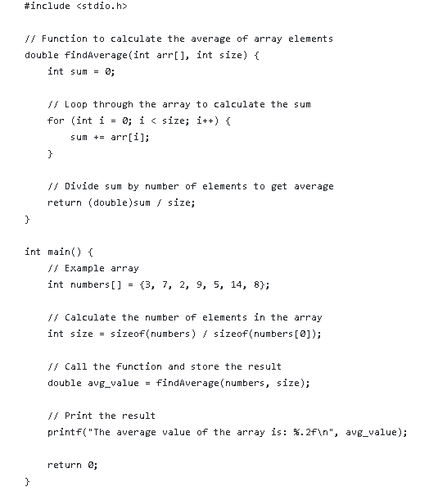
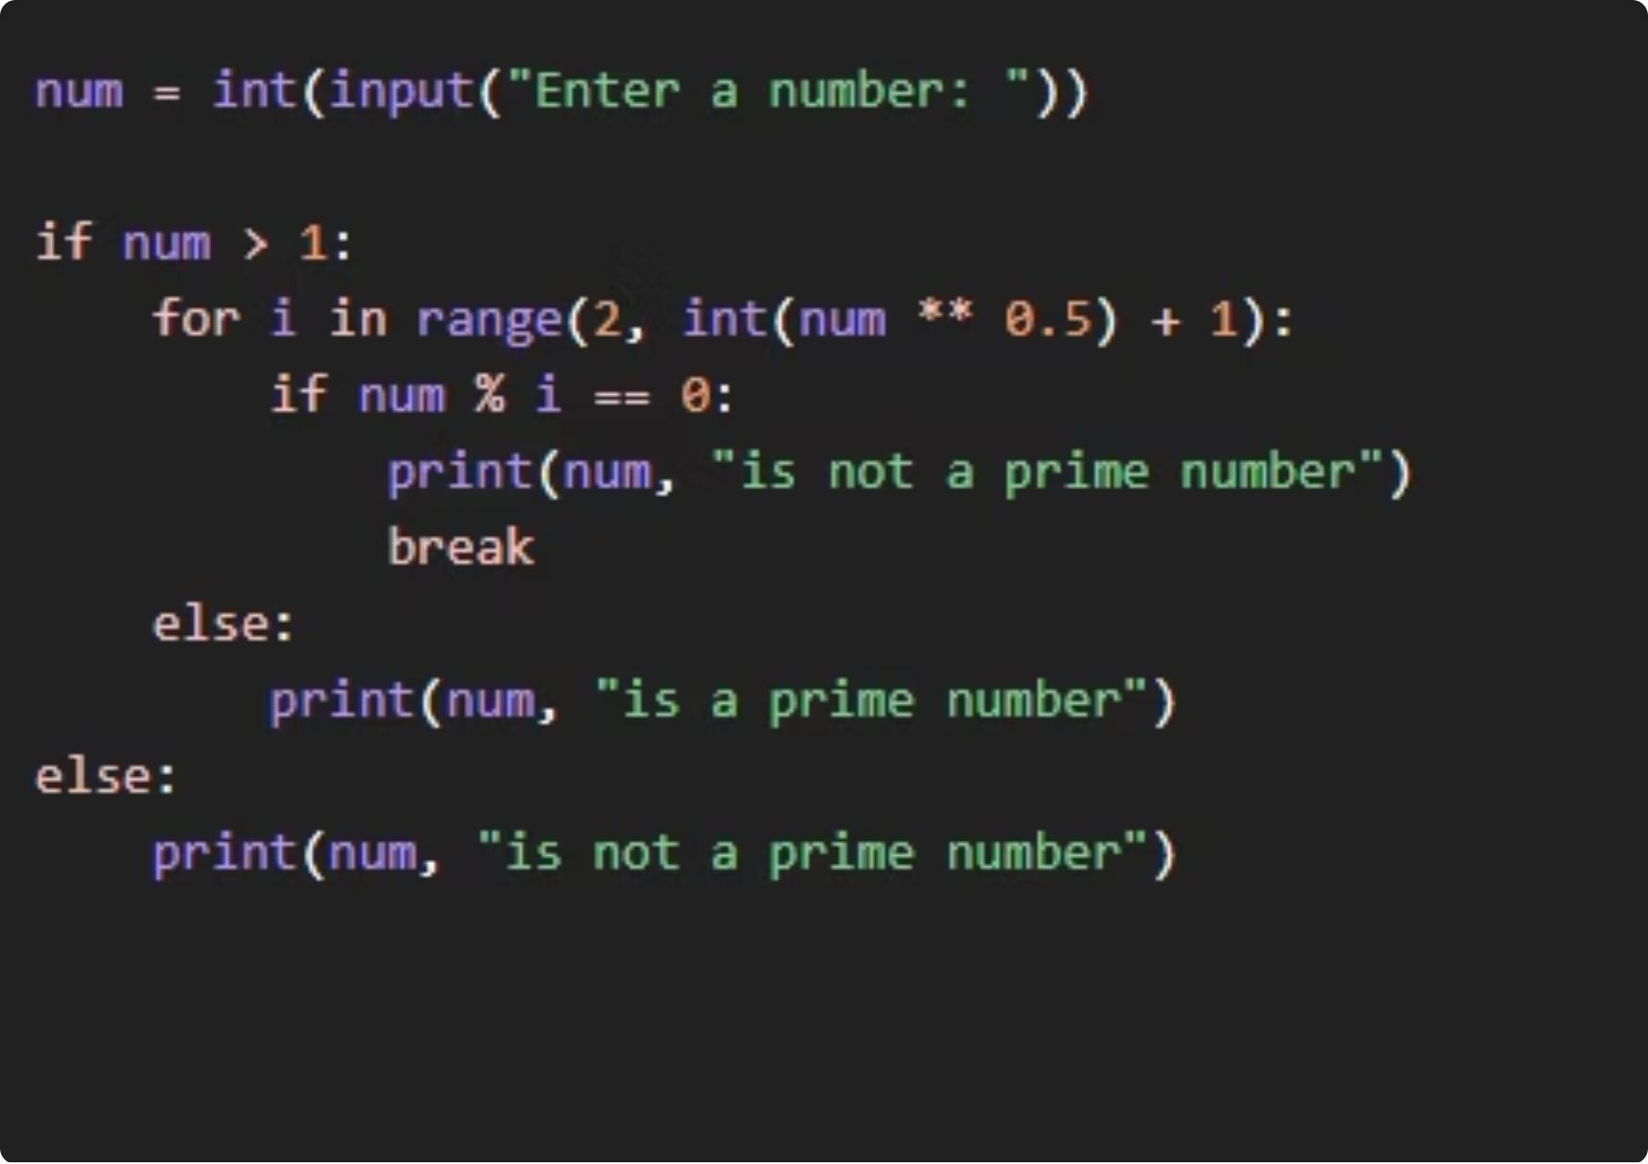

Project 1
Average of Array Elements
Problem Statement
Basic array operations often focus on extremes (maximum/minimum), but analyzing datasets requires understanding central tendencies like averages, which provide a balanced measure of overall values.
Proposed Solution
Develop a C program that efficiently computes the average of array elements using a single traversal, ensuring accuracy and low computational overhead.
Core Mechanism
Implements a loop to accumulate the sum of all elements, then divides by the total count to yield the average. Uses type casting to ensure floating-point precision.
PYTHON
GIT
GITHUB

Slide 6


Project 2
Face.com Biometric Analysis Platform
Model Studied:
DeepSeek-R1 hosted on the Hugging Face AI Hub.
Biometric Core: Integrates Face.com API methodologies alongside open-source transformer reasoning spaces for high-fidelity facial tracking and automated parameter mining.
System Problem: Processing raw pixel coordinate arrays manually requires excessive tensor calculations, massive computer vision training timelines, and prone-to-error heuristics.
The Solution: An AI-driven interface that queries trained vision pipelines to instantly return structured, lightweight facial point telemetry sets
Architecture & Parameters
Training & Applications
Advantages & Limitations
Transformer-based design with billions of parameters enabling advanced reasoning.
Trained on large-scale datasets; applied across NLP, reasoning, and generation tasks.
High accuracy and versatility, balanced against compute cost and bias considerations.

Slide 7

Project 3
Engineering E-Profile
Core Objective: Construct a professional, lightning-fast, secure, modern web portal detailing scholastic merits, technical competencies, core toolsets, and active software portfolios.
Interface Foundations: Developed with a sophisticated, high-contrast dark theme to minimize eye strain, utilizing responsive layouts and fluid CSS styling architecture.
Live Deployment Infrastructure: Successfully pushed, versioned, and hosted live globally on the serverless distribution layer of GitHub Pages.
Premium UI Layouts: Features a floating frosted-glass navigation grid, custom CSS variables for rapid theme adaptation, and responsive container columns.
Interactive Core Dynamics: Integrates lightweight JavaScript logic engine instances to handle responsive menu toggles and fluid state modifications without performance degradation.
.
HTML5
CSS3
JAVASCRIPT
GITHUB PAGES
https://dilipnaidhruva.github.io/E-profile/

Slide 8
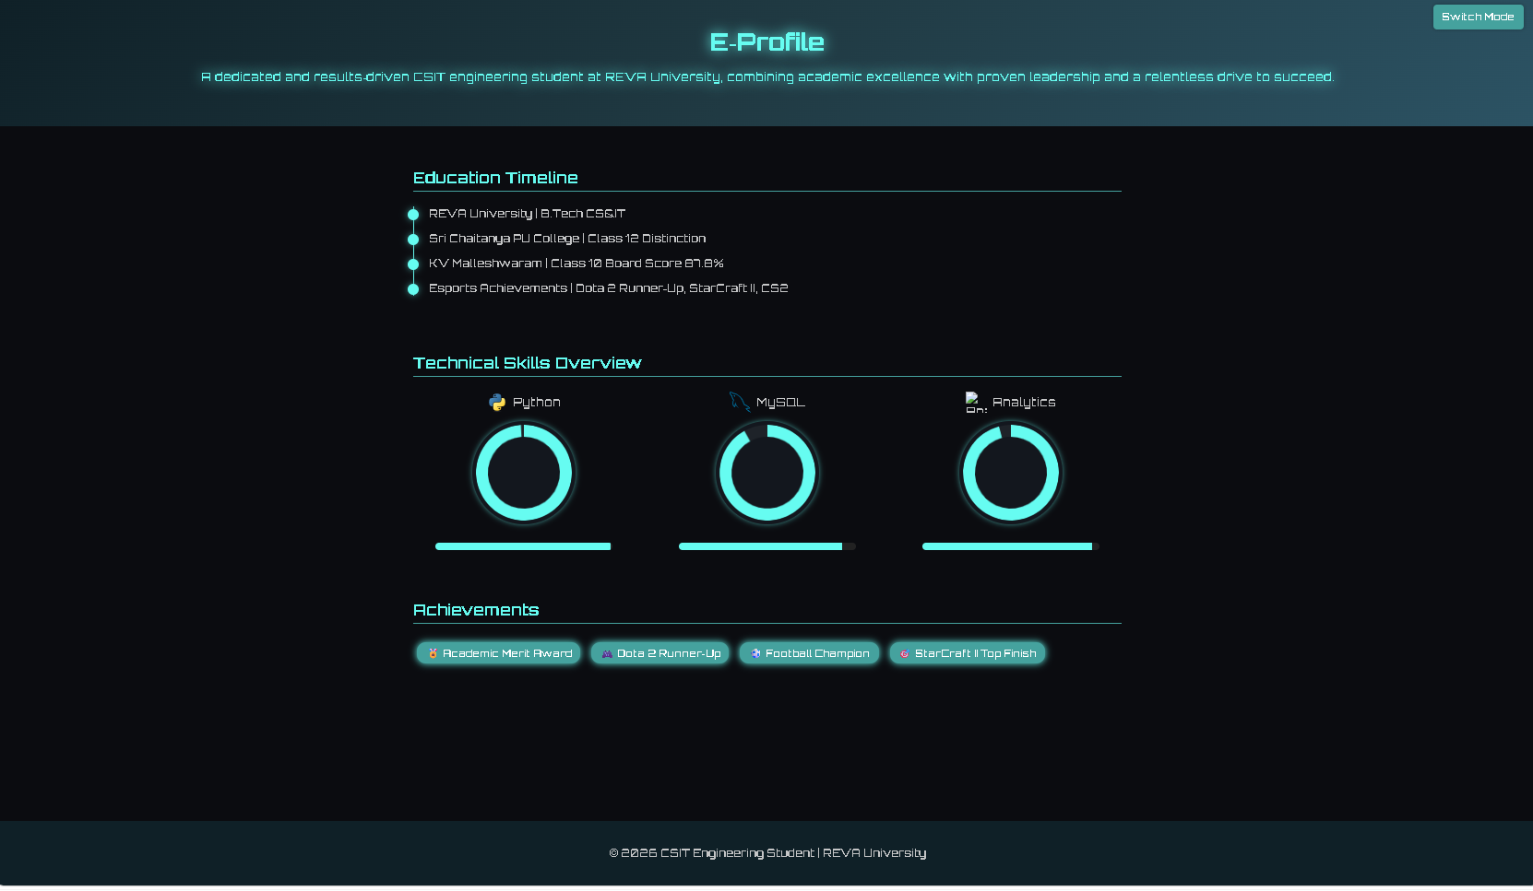

Slide 9

Project 4 – Distributed News Analytics Platform
Source Mechanics: Engineered using pure semantic components to ensure maximum readability and rapid DOM rendering speeds.
Layout Design Grid: Implements responsive flex containers and grid columns that adapt seamlessly across devices, automatically rearranging heavy content matrices.
Dynamic Article Interactions: Embedded client-side interactivity featuring custom search functions, category filters, and an asynchronous.
Live Deployment Infrastructure: Successfully pushed, version-controlled, and actively hosted using the cloud infrastructure of GitHub Pages.
Objective: Construct an
enterprise-ready, multi-sector
digital news platform showcasing responsive
content delivery across diverse layouts
Core Layout Channels Deployed: A multi-column article grid spanning diverse topical categories including Technology, Science, Business, Sports, Medical Innovation, and Quantum Computing.
Category Navigation
News Cards & Responsive Layout
Organized sections for easy content discovery
Mobile-friendly card-based design
This Photo by Unknown Author is licensed under CC BY

Slide 10
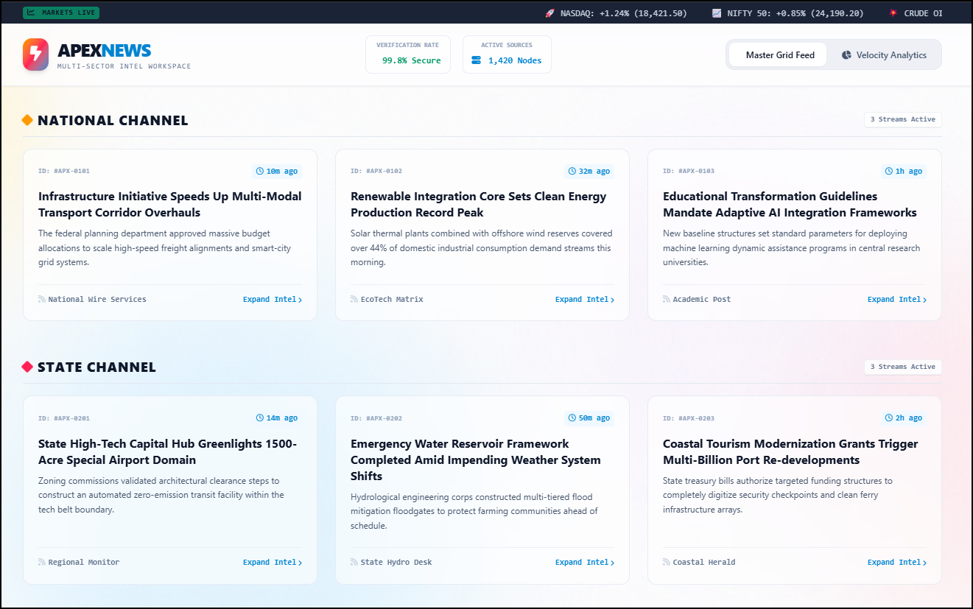

Slide 11
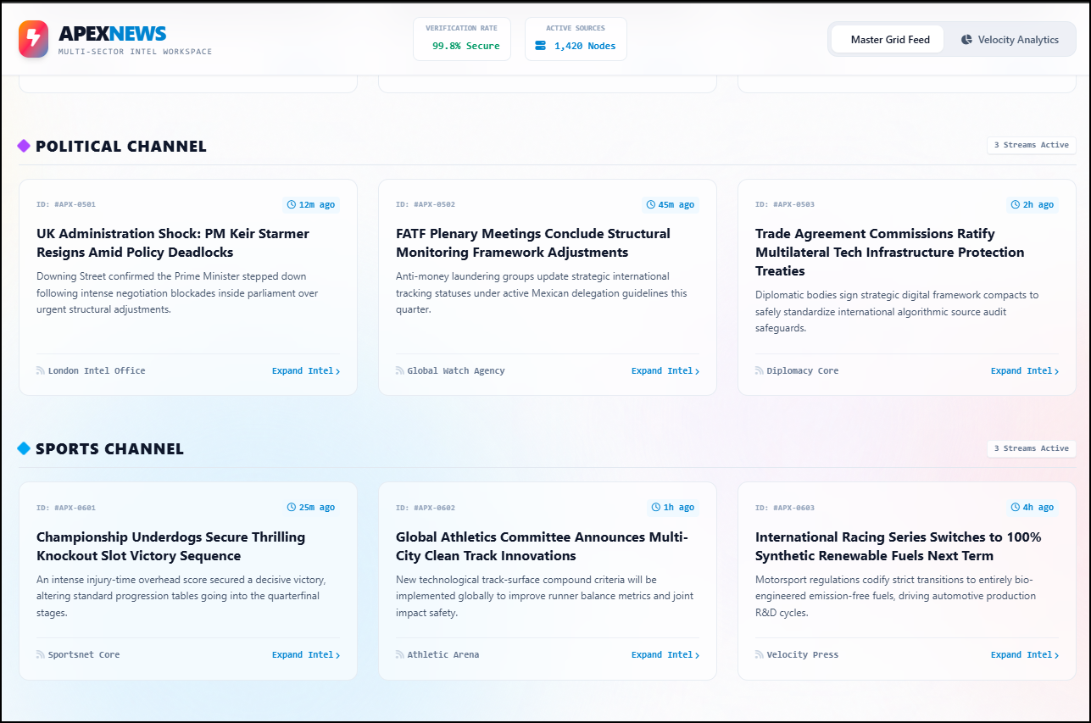

Slide 12

TECHNOLOGY
A curated set of modern tools spanning programming, version control, web development, and AI.
Python
Git & GitHub
Core programming language for algorithmic problem-solving
Version control and collaborative code management
HTML5 · CSS3 · JS
GitHub Pages
Front-end triad for responsive web development
Free cloud hosting for static websites
Hugging Face
Responsive Design
AI model hub for analysis and deployment
Cross-device layouts for all screen sizes
This Photo by Unknown Author is licensed under CC BY

Slide 13


DEPLOYMENT WORKFLOW
Every project follows a structured pipeline from concept to live deployment ensuring version control, collaboration, and public accessibility at each stage.
The development lifecycle of these GitHub projects follows a structured pipeline where an initial idea is accelerated using Gemini's AI capabilities,
written into clean source code, version-controlled with atomic Git commits, and ultimately hosted live for public accessibility via GitHub Pages or Hugging Face.
Idea
Development
GitHub Repo
Commit
GitHub Pages
This workflow emphasizes version control, cloud hosting, and live project sharing — core practices in modern software engineering.

Slide 14

Learning Outcomes & Future Scope
✔ 4 Projects Completed
✔ Git & GitHub
Python tooling, AI analysis, and two deployed websites
Version control, branching, and collaborative workflows
✔ Cloud Deployment
✔ AI & ML Exposure
Live hosting via GitHub Pages with public URLs
Hands-on analysis of DeepSeek-R1 on Hugging Face
FUTURE SCOPE
Build full-stack web applications with backend APIs
Integrate REST APIs and third-party services
Explore AI model fine-tuning and deployment
Contribute to open-source projects on GitHub

Slide 15

THANK YOU
Presented By:
DILIP NAIDHRUVA K
CSIT A (R25EJ029)
REVA UNIVERSITY

